Slide 1
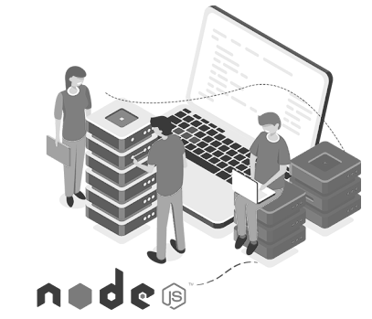

BACK-END DEVELOPMENT
WEEK 3 – Express Basics + POST + Middleware

Slide 2
After Finishing This Lecture:
Create a basic HTTP server using Express.js
Route HTTP requests using Express.js method
Extract query parameters and request body using express.json
Understand how Express request and response objects work

Slide 3

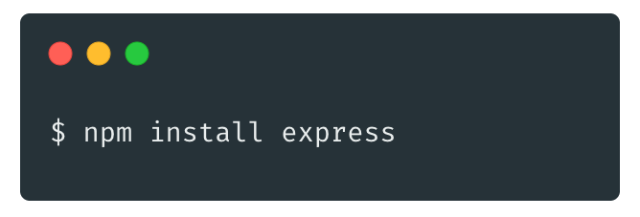
What is Express.js
Express.js is a minimal and flexible Node.js web application framework
Provides essential features for building web.
Simplifies the creation of server-side applications through its abstractions and unobtrusive interface.

Slide 4
Why Express?
Minimalist Web Framework: Express.js is designed to be minimal yet powerful, providing just the essential building blocks. This allows developers to start small and scale complexity as needed without unnecessary bloat.
Abstracts Boilerplate: Express simplifies the repetitive tasks associated with Node.js development by abstracting boilerplate code, allowing developers to focus on application logic rather than infrastructure setup.

Slide 5
Why Express?
Routing: One of the standout features of Express is its routing capabilities, which enable you to define routes for different HTTP methods and URLs, thereby structuring your application logically and intuitively.
Middleware: The concept of middleware is central to Express, empowering developers to process requests and responses in a flexible way. Middleware functions can perform a range of tasks from logging, authentication to serving static files.

Slide 6
Why Express? (Cont)
JSON Parsing: Express comes built-in with middleware functionalities such as express.json(), which parses incoming requests with JSON payloads, facilitating easier manipulation of request data.
Static Files: Serving static files such as images, CSS, and JavaScript is made easy through the express.static() middleware, allowing for straightforward integration of frontend assets into your application.

Slide 7
Why Express? (Cont)
URL Parsing and HTTP Headers: Express streamlines handling URLs and HTTP headers, making it simple to access query parameters and header information within a request, enhancing overall application robustness.

Slide 8
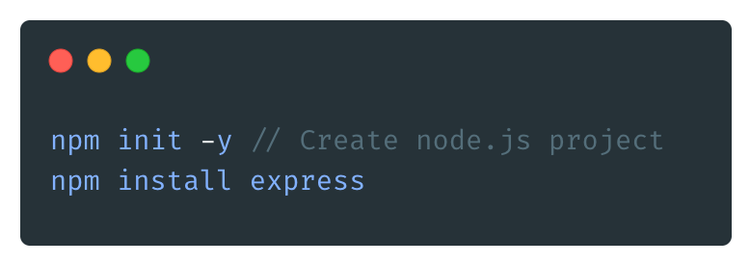
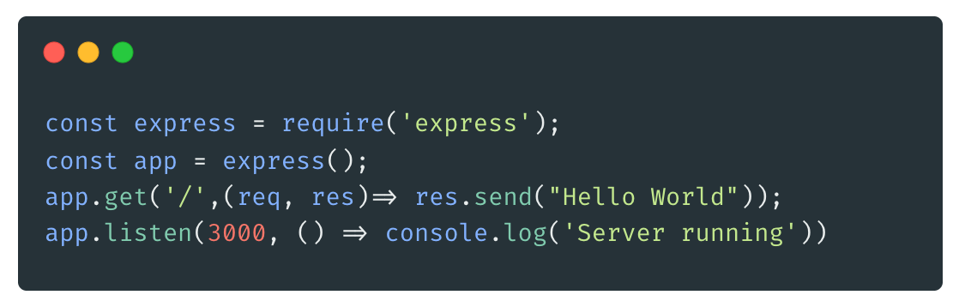
Setting Up Express
Activity
How is it similar to native HTTP module?
How is it abstracted comparing to HTTP module?

Slide 9
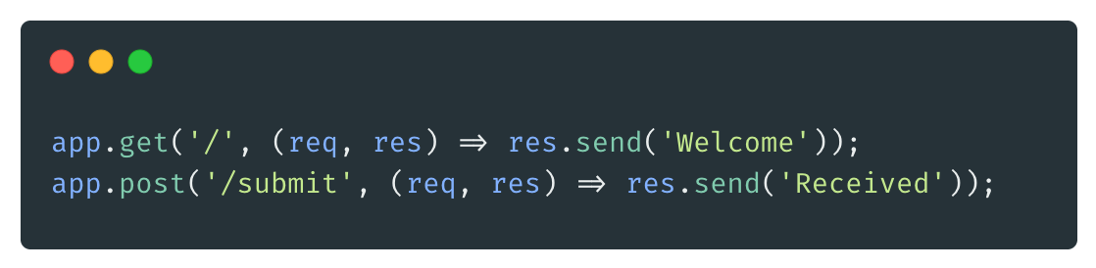
Defining Routes
app.get(path, handler) for reading
app.post(path, handler) for creating
req and res objects
Questions
How about other HTTP methods? (Delete, Put, Patch)

Slide 10
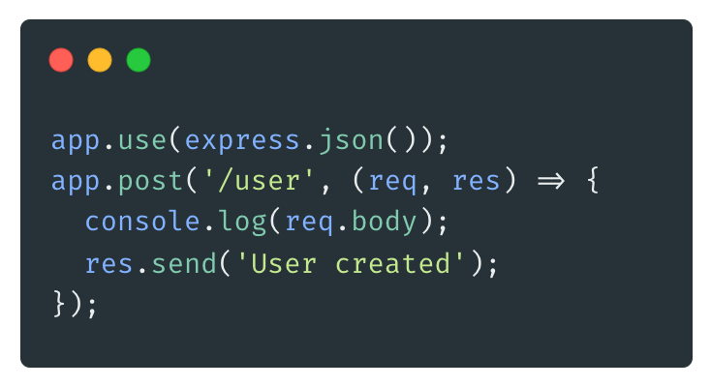
Requires express.json() middleware
Handling POST Data

Slide 11
Request and Response Objects
The req object represents the incoming HTTP request. It contains:
req.params → route parameters
req.query → query string parameters
req.body → body of POST/PUT requests (after express.json())
req.method → HTTP method (GET, POST, etc.)
req.url → full request path

Slide 12
Request and Response Objects (Cont)
The res object is used to send a response back to the client:
res.send() → send plain text, HTML, or JSON
res.json() → send a JSON object
res.status() → set HTTP status code
res.redirect() → redirect to another route

Slide 13
Dynamic & Query Params
/users/:id → req.params.id
/users?id=12 → req.query.id
/users/45 → req.params.id = ??
/users?id=24 → req.query.id = ??

Slide 14
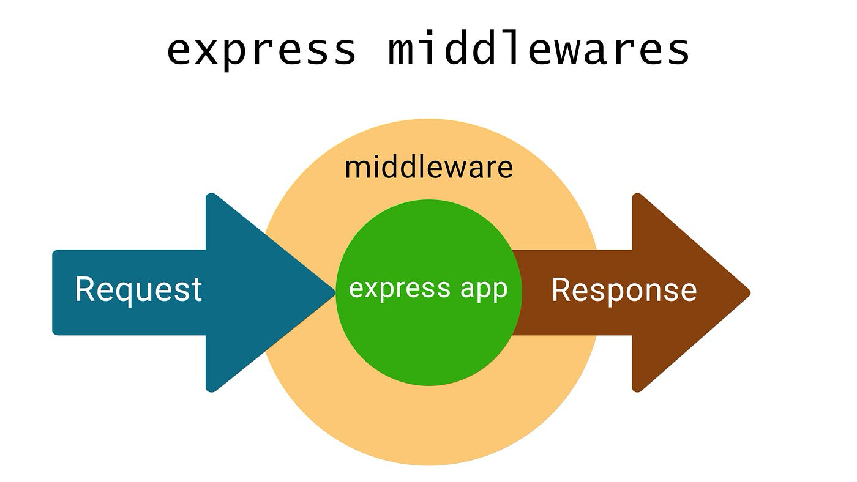
What is Middleware?
Middleware functions are functions that run before your route handler. They can:
Modify the req and res objects
End the request-response cycle (res.send, etc.)
Call the next middleware using next()

Slide 15
What is Middleware?
Imagine entering an airport:
🧍 You (the request) walk in
🛃 Middleware 1 = Security Check
🧾 Middleware 2 = Passport Control
🎯 Route Handler = Boarding Gate

Slide 16
Request-Response Lifecycle Visualization
Client --> Middleware 1 --> Middleware 2 --> Route Handler --> Response
| | |
modifies req logs request sends final res
| | |
next() next() res.send()

Slide 17
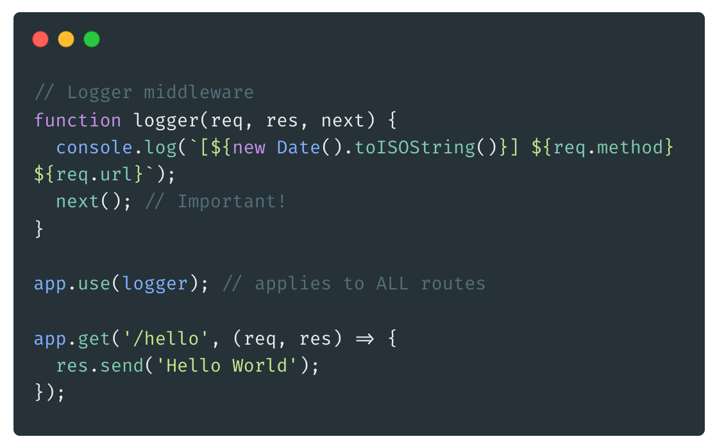
Basic Middleware Example
Question:
What happens if we don’t call next()?
Where would you put middleware that checks for auth?

Slide 18
Type | Example
Application | app.use(logger)
Router-level | router.use(authCheck)
Built-in | express.json()
Error-handling | (err, req, res, next) =>
Third-party | morgan, cors, etc.
Types of Middleware

Slide 19
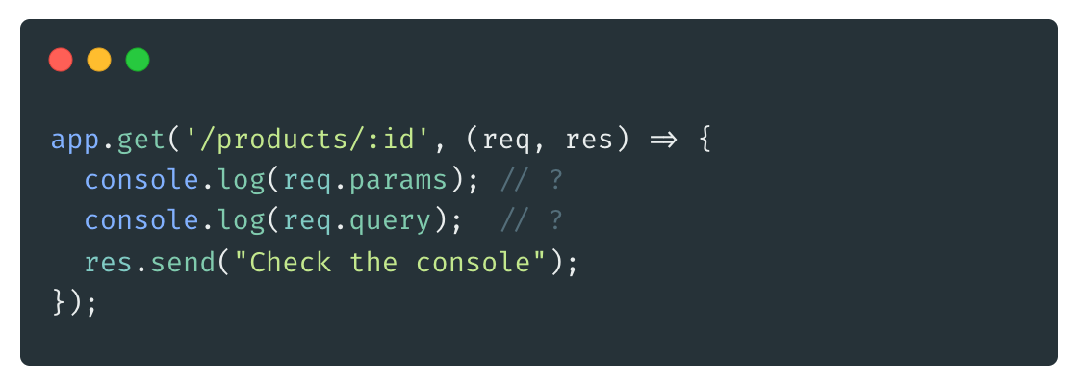
Mini Activity
Try it yourself! What would be logged and returned for: /products/42?category=books

Slide 20
Mini Activity : Answer
req.params = { id: '42' }
req.query = { category: 'books' }

Slide 21

WHAT WE HAVE LEARNT
Create a basic HTTP server using Express.js
Route HTTP requests using Express.js method
Extract query parameters and request body using express.json
Understand how Express request and response objects work

